Slide 1

SQL
The questing beast
Sir Thomas Mallory

Slide 2
SQL
A standard
  ANSI
  ISO
SQL skills are in demand
Developed by IBM
Object-oriented extensions created

Slide 3
SQL
A complete database language
Data definition
  Definition of tables and views
Data manipulation
  Specifying queries
  Maintaining a database
    INSERT
    UPDATE
    DELETE

Slide 4
SQL
Not a complete programming language
Used in conjunction with complete programming languages
  e.g., COBOL and Java
  Embedded SQL

Slide 5
Data definition
Table, views, and indexes can be defined while the system is operational
Base table
  An autonomous, named table
CREATE TABLE

Slide 6
Constraints
Primary key
CONSTRAINT pk_stock PRIMARY KEY(stkcode);
Foreign key
CONSTRAINT fk_stock_nation
FOREIGN KEY(natcode) REFERENCES nation;
Unique
CONSTRAINT unq_stock_stkname UNIQUE(stkname);

Slide 7
Check constraint
Table & Column
Table
CREATE TABLE item (
itemcode INTEGER,
CONSTRAINT chk_item_itemcode CHECK(itemcode <500));
Column
CREATE TABLE item (
itemcode INTEGER
CONSTRAINT chk_item_itemcode CHECK(itemcode <500),
itemcolor VARCHAR(10));

Slide 8
Check constraint
Domain
CREATE DOMAIN valid_color AS CHAR(10)
CONSTRAINT chk_qitem_color CHECK(
VALUE IN ('Bamboo',’Black',’Brown',Green', 'Khaki',’White'));
CREATE TABLE item (
itemcode INTEGER,
itemcolor VALID_COLOR);

Slide 9
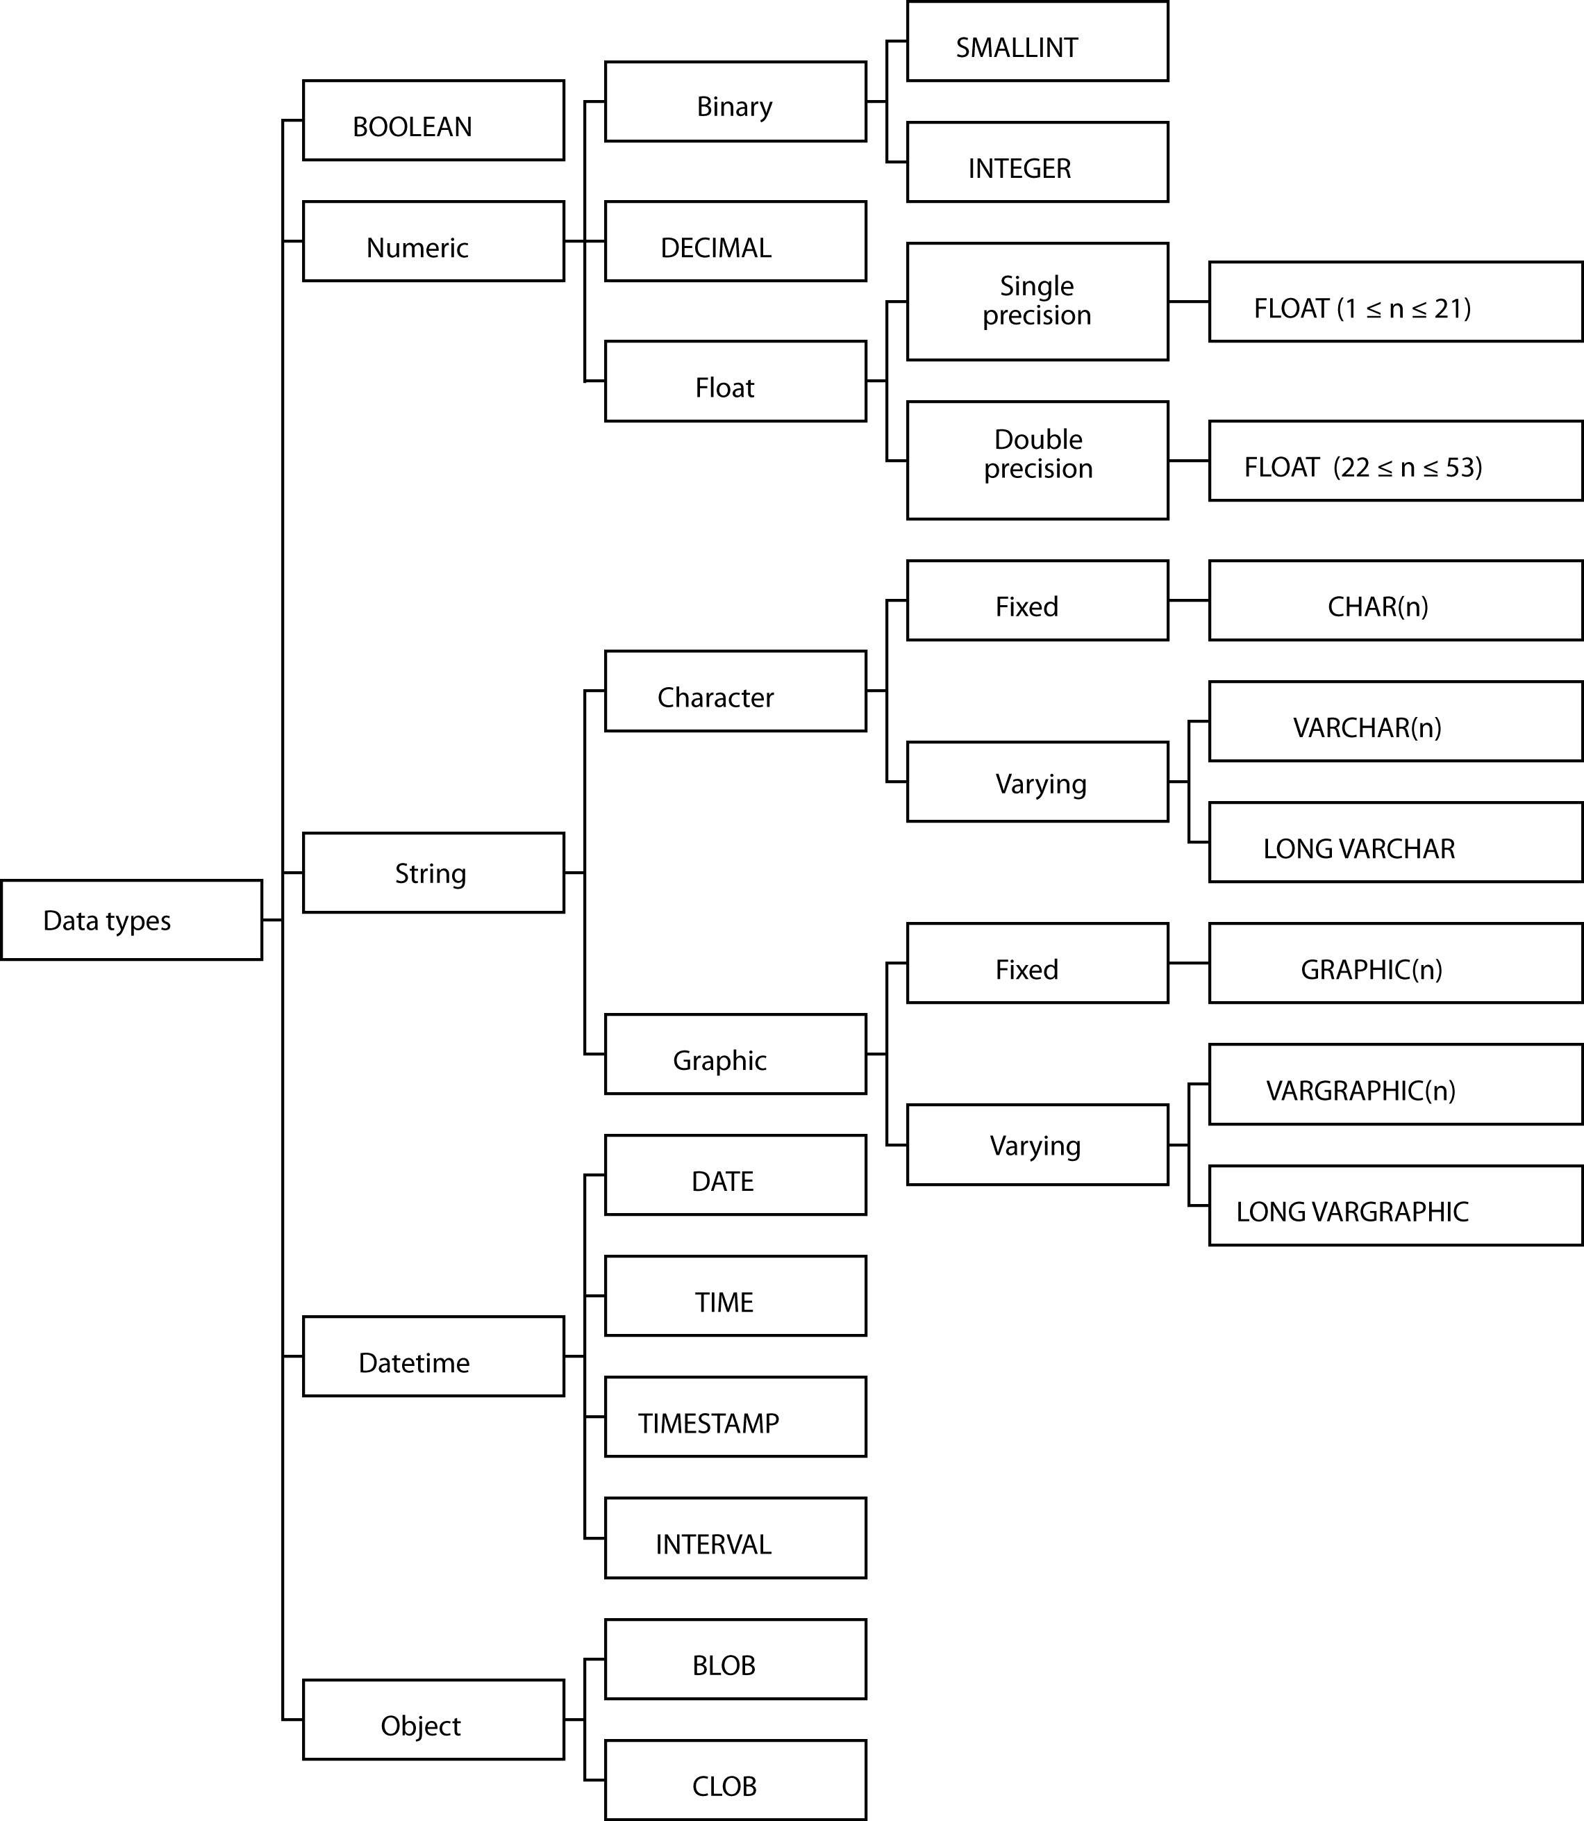
Data types

Slide 10
Data types
BOOLEAN
INTEGER
  31 binary digits
SMALLINT
  15 binary digits
FLOAT
  Scientific work
DECIMAL
  Commercial applications
CHAR and VARCHAR
  Character strings
DATE, TIME, TIMESTAMP, and INTERVAL
BLOB and CLOB

Slide 11
Changing a table
ALTER TABLE
  Adding one new column at a time
  Cannot be used to
    Change a column’s storage format
    Delete an unwanted column
DROP TABLE
  Deletes a table

Slide 12
A view
CREATE VIEW
DROP VIEW

Slide 13
An index
CREATE INDEX
DROP INDEX

Slide 14
Data manipulation statements
INSERT
UPDATE
DELETE
SELECT

Slide 15

INSERT
One row
Multiple rows
With a subquery - like a copy
  INSERT INTO STOCK
  (stkcode, stkfirm, stkprice, stkdiv, stkpe)
  SELECT code, firm, price, div, pe
  FROM download WHERE code IN
  ('FC','PT','AR','SLG','ILZ','BE','BS','NG',
  'CS','ROF');

Slide 16
UPDATE
One row
Multiple rows
All rows

Slide 17
DELETE
One row
Multiple rows
All rows
  Not the same as DROP TABLE

Slide 18
Product
All rows of the first table concatenated with all possible rows of the second table
Form the product of stock and nation
  SELECT * FROM stock, nation;

Slide 19
Product
Find the percentage of Australian stocks in the portfolio.
CREATE VIEW austotal (auscount) AS
SELECT COUNT(*) FROM stock WHERE natcode = 'AUS';
CREATE VIEW TOTAL (totalcount) AS
SELECT COUNT(*) FROM stock;
SELECT DECIMAL((FLOAT(auscount)/
FLOAT(totalcount)*100),5,2)
AS percentage FROM austotal, total;
18.75

Slide 20
Join
Join creates a new table from two existing tables by matching on a column common to both tables
Equijoin
  The new table contains two identical columns
  SELECT * FROM stock, nation
  WHERE stock.natcode = nation.natcode;

Slide 21
Join variations
SELECT * FROM stock INNER JOIN nation USING (natcode);
SELECT * FROM stock NATURAL JOIN nation;

Slide 22
Outer join
Left outer join
  An inner join plus those rows from t1 not included in the inner join
  SELECT * FROM t1 LEFT JOIN t2 USING (id);
t1 |  |  | t2
id | col1 |  | id | col2
1 | a |  | 1 | x
2 | b |  | 3 | y
3 | c |  | 5 | z
t1.id | col1 | t2.id | col2
1 | a | 1 | x
2 | b | null | null
3 | c | 3 | y

Slide 23
Outer join
Right outer join
An inner join plus those rows from t2 not included in the inner join
SELECT * FROM t1 RIGHT JOIN t2 USING (id);
t1 |  |  | t2
id | col1 |  | id | col2
1 | a |  | 1 | x
2 | b |  | 3 | y
3 | c |  | 5 | z
t1.id | col1 | t2.id | col2
1 | a | 1 | x
3 | c | 3 | y
null | null | 5 | z

Slide 24
Outer join
Full outer join
An inner join plus those rows from t1 and t2 not included in the inner join
  SELECT * FROM t1 FULL JOIN t2 USING (id);
t1 |  |  | t2
id | col1 |  | id | col2
1 | a |  | 1 | x
2 | b |  | 3 | y
3 | c |  | 5 | z
t1.id | col1 | t2.id | col2
1 | a | 1 | x
2 | b | null | null
3 | c | 3 | y
null | null | 5 | z

Slide 25
Outer join
Left join example
  List all items with details of deliveries if any have been made (see page 284)
  SELECT * FROM qitem LEFT JOIN qdel USING (itemname);
Right join example
  List all departments and any sales they have made
  SELECT * FROM qsale RIGHT JOIN qdept USING (deptname);

Slide 26
Theta join
Join is a product with a condition clause
The condition is not restricted to equality.
A theta join is the general version
Theta is a variable that can take any value from the set [=, <>, >, ≥, <, ≤]

Slide 27
Correlated subquery
The inner query is evaluated many times rather than once
  Find those stocks where the quantity is greater than the average for that country.
  SELECT natname, stkfirm, stkqty FROM stock, nation
  WHERE stock.natcode = nation.natcode
  AND stkqty >
  (SELECT AVG(stkqty) FROM stock
  WHERE stock.natcode = nation.natcode);

Slide 28
Correlated subquery
Clue
  The need to compare each row of a table against a function (e.g., average or count) for some rows of a column
Must be used with EXISTS and NOT EXISTS

Slide 29
Aggregate functions
COUNT
SUM
AVG
MAX
MIN

Slide 30
SQL Routines
Functions
Procedures
Introduced in SQL-99
  Not all vendors compliant with the standard
Improve flexibility, productivity, and enforcement of business rules

Slide 31
SQL function
Similar purpose to built-in functions
CREATE FUNCTION km_to_miles()
RETURNS FLOAT
CONTAINS SQL
RETURN 0.6213712;
Use in SQL
SELECT distance*km_to_miles FROM travel;

Slide 32
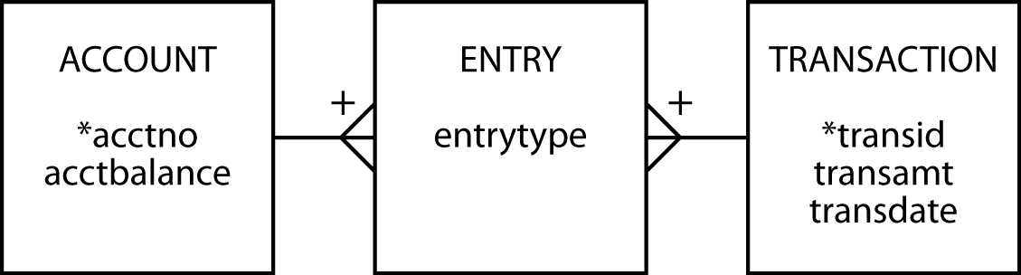
SQL procedure
A stored procedure is SQL code that is dynamically loaded and executed by a CALL statement
Accounting example

Slide 33
SQL procedure
CREATE PROCEDURE transfer (
IN cracct INTEGER,
IN dbacct INTEGER,
IN amt DECIMAL(9,2),
IN transno INTEGER)
LANGUAGE SQL
BEGIN
INSERT INTO transaction VALUES (transno, amt, current date);
UPDATE account
SET acctbalance = acctbalance + amt
WHERE acctno = cracct;
INSERT INTO entry VALUES(transno, cracct, 'cr');
UPDATE account
SET acctbalance = acctbalance - amt
WHERE acctno = dbacct;
INSERT INTO entry VALUES (transno, dbacct, 'db');
END;

Slide 34
SQL procedure
Execution
  CALL transfer(cracct, dbacct, amt, transno);
Example
  Transaction 1005 transfers $100 to account 1 (the credit account) from account 2 (the debit account)
  CALL transfer(1,2,100,1005);

Slide 35
Trigger
A set of actions set off by an SQL statement that changes the state of the database
  UPDATE
  INSERT
  DELETE

Slide 36
Trigger
Automatically log all updates to a log file
  Create a table for storing log rows
  Create a trigger
CREATE TABLE stock_log (
stkcode CHAR(3),
old_stkprice DECIMAL(6,2),
new_stkprice DECIMAL(6,2),
old_stkqty DECIMAL(8),
new_stkqty DECIMAL(8),
update_stktime TIMESTAMP NOT NULL,
PRIMARY KEY(update_stktime));

Slide 37
Trigger
CREATE TRIGGER stock_update
AFTER UPDATE ON stock
REFERENCING old AS old_row new AS new_row
FOR EACH ROW MODE db2sq1
INSERT INTO stock_log VALUES
(old_row.stkcode, old_row.stkprice, new_row.stkprice, old_row.stkqty, new_row.stkqty, CURRENT TIMESTAMP);

Slide 38
Nulls
Don’t confuse with blank or zero
Multiple meanings
  Unknown data
  Inapplicable data
  No value supplied
  Value undefined
Create confusion because the user must make an inference
Date advises that NOT NULL be used for all columns to avoid confusion
Notes:
How might you indicate a column is NULL?
DB2 has a hidden one-character column preceding each column that is used to indicate whether a column is NULL.

Slide 39
Security
Data is a valuable resource
Access should be controlled
SQL security procedures
  CREATE VIEW
  Authorization commands

Slide 40
Authorization
Based on privilege concept
You cannot execute an operation without the appropriate privilege
DBA has all privileges

Slide 41
GRANT
Defines a user’s privileges
Format
  GRANT privileges ON object TO users
  [WITH GRANT OPTION];
An object is a base table or view
The keyword privilege can be ALL PRIVILEGES or chosen from
  SELECT
  UPDATE
  DELETE
  INSERT
Privileges can be granted to everybody using the keyword PUBLIC or to selected users by specifying their user identifier

Slide 42
GRANT
The UPDATE privilege can specify particular columns in a base table or view
Some privileges apply only to base tables
  ALTER
  INDEX
WITH GRANT OPTION
  Permits a user to pass privileges to another user

Slide 43
Using GRANT
Give Alice all rights to the STOCK table.
GRANT ALL PRIVILEGES ON stock TO alice;
Permit the accounting staff, Todd and Nancy, to update the price of a stock.
GRANT UPDATE (stkprice) ON stock TO todd, nancy;
Give all staff the privilege to select rows from ITEM.
GRANT SELECT ON item TO PUBLIC;
Give Alice all rights to view STK.
GRANT SELECT, UPDATE, DELETE, INSERT ON stk
TO alice;
Notes:
Why wasn’t ALL PRIVILEGES used?
Since STK is a view, ALICE cannot be granted ALL PRIVILEGES since this would include ALTER and INDEX privileges for a view

Slide 44
REVOKE
Removes privileges
Format
  REVOKE privileges ON object FROM users;
Cascading REVOKE
  Reverses use of the WITH GRANT OPTION
  When a user’s privileges are revoked, all users whose privileges were established using WITH GRANT OPTION are also revoked

Slide 45
Using REVOKE
Remove Sophie's ability to select from ITEM.
REVOKE SELECT ON item FROM sophie;
Nancy is no longer permitted to update stock prices.
REVOKE UPDATE ON stock FROM nancy;
Notes:
A revoked UPDATE is not column specific

Slide 46
The catalog
A relational database containing definitions of base tables, view, etc.
Can be interrogated using SQL
Called systems tables rather than base tables
Key tables are
  syscatalog
  syscolumns
  sysindexes

Slide 47
Interrogating the catalog
Find the table(s) with the most columns.
SELECT tname FROM system.syscatalog
WHERE ncols = (SELECT MAX(ncols)
FROM system.syscatalog);
What columns in what tables store dates?
SELECT tname, cname FROM system.syscolumns
WHERE coltype = 'date';

Slide 48
Natural language processing

Slide 49
Open Database Connectivity (ODBC)
Application
ODBC API
ODBC driver manager
Service provide API
Driver for DBMS server
DBMS server

Slide 50
Embedded SQL
SQL is not a stand-alone programming language
SQL statements can be embedded in application programs
The incompatibility between the table processing of SQL and record-at-time processing of COBOL is addressed using a cursor

Slide 51
MS Access and SQL
Strengths
  Interface
  SQL DML
  Referential integrity
  Fast execution
  Views (queries)
  Updateable views
Weaknesses
  No support for GRANT and REVOKE
  Domains
  No support for COMMIT and ROLLBACK
  Limited concurrency control

Slide 52
The future of SQL
One of the most successful standardization stories
Highly portable
Objects have made standardization more difficult as vendors have added extensions prior to standards setting

Slide 53
SQL-99
Better support for Java and other object-oriented languages
Support for multimedia extensions
Retention of portability by defining standards for object-oriented extensions to the relational model
Enhancements add functionality at the expense of ease of use

Slide 54
User-defined data types
May be used in the same way as built-in data types
A UDT is defined by
  Specifying a set of declarations of the stored attributes that represent the value of the UDT
  The operations that define the equality and ordering relationships of the UDT
  The operations and derived attributes that represent the behavior of the UDT

Slide 55
SQLJ
Simplifies the interface to Java
ANSI standard
Integration of SQL and Java reinforces the adoption and use of Java for enterprise data-intensive applications
A good choice for static SQL programming tasks
Use JDBC for dynamic tasks

Slide 56
Key points
SQL is a standard
  It matters little which implementation you use for learning SQL
Data definition language (DDL)
  CREATE TABLE
  Constraint
  CREATE INDEX
Data manipulation language (DML)
  SELECT
  INSERT
  UPDATE
  DELETE

Slide 57
Key points
SQL routines
  Function
  Procedure
  Triggers
Security
  GRANT
  REVOKE
Connectivity
Embedded SQL
SQL-99

